Slide 1
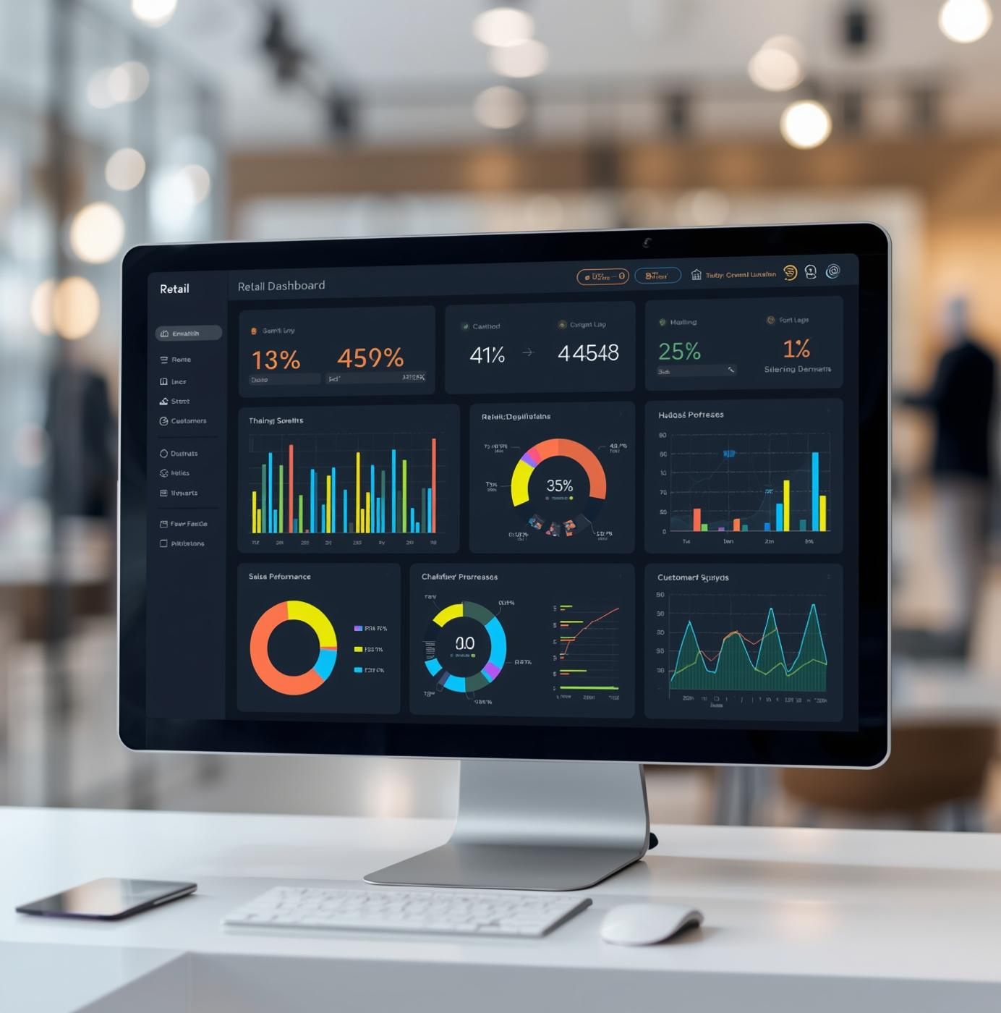
EXCEL CASE STUDY
Retail Sales and Customer Analysis
This presentation provides an overview of a sales and customer analysis case study conducted using Microsoft Excel. The analysis focuses on key performance indicators and trends to provide actionable insights.
Presented by: Ritu

Slide 2
Retail sales project outline:
The dataset captures detailed online retail transactions, including invoices, products, prices, and customer information across multiple countries.
Data cleaning ensures accuracy by removing duplicate records and isolating only valid, non-cancelled transactions for analysis.
Cancellation flagging helps track total refunded or reversed sales, improving financial accuracy and fraud monitoring.
Sales performance analysis identifies the top 5 best-selling products both by quantity and total revenue, revealing popular and high-value items.
Pricing strategy insights highlight products priced above the 90th percentile, useful for evaluating premium items and profit margins.
Customer analysis ranks the top 10 spenders, showing which customers drive the majority of sales—valuable for loyalty or reward programs.
Monthly trend charts display seasonal sales fluctuations, helping businesses plan inventory and marketing around peak months.
Geographical insights reveal which country records the highest number of transactions, pointing to key markets for expansion.
Product return rate analysis helps identify items with frequent cancellations or returns, indicating potential quality or logistics issues.
The interactive dashboard consolidates KPIs such as total sales, top products, and sales by region—offering a real-time view for better decision-making.

Slide 3

Data Cleaning Techniques
Effective data cleaning is crucial for maintaining data integrity in retail analysis. This section discusses identifying and removing duplicate records using Excel features. By ensuring unique transaction identifiers, we can enhance accuracy for subsequent sales and customer analyses.

Slide 4
Handling Cancellations
Non-cancelled transactions contribute a strong positive revenue of 624,780.98, showing that the majority of orders are successfully completed.
Cancelled transactions result in a negative value of –214,940.76, reflecting a considerable loss due to cancellations.
The difference between completed and cancelled transaction values shows a positive net impact of 409,840.22 on overall revenue.
Reducing cancellations could help recover a portion of the 214,940.76 loss and further improve total revenue performance.
This section delves into the importance of tracking cancellations within retail sales. By flagging canceled transactions and calculating their total value, we gain insights into their impact on overall sales performance and customer behavior, guiding future sales strategies.

Slide 5

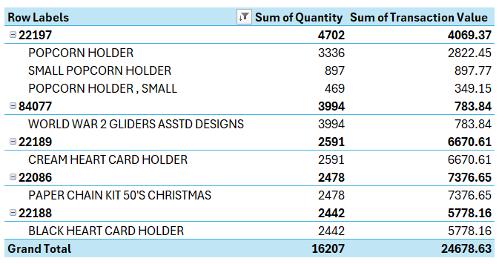
Sales Performance Analysis
Popcorn Holder products collectively show strong activity, with multiple variants contributing to the total quantity and revenue under their product code.
World War 2 Gliders Asstd Designs stands out as a single-item category that still generates notable overall movement.
Cream Heart Card Holder appears as a focused product line with consistent performance under its corresponding product code.
Paper Chain Kit 50's Christmas shows significant engagement, indicating seasonal or themed demand within its category.
Black Heart Card Holder demonstrates solid sales contribution despite being a single-item grouping.
Overall, the listed product codes highlight a mix of multi-item and single-item categories, each playing an important role in total quantity and transaction value.

Slide 6
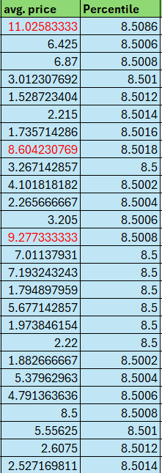
Pricing Strategy Analysis
The avg. price column shows variation from very low values like 1.52 to higher values such as 11.03, indicating wide pricing differences among items.
Items with noticeably high average prices—such as 11.0258, 9.2773, and 8.6042—stand out compared to the majority of mid-range values.
The Percentile column remains clustered around 8.5, showing that the price distribution is tightly concentrated except for a few high-value items.
The items highlighted in red (e.g., 11.0258, 8.6042, 9.2773) appear to be those exceeding the 90th percentile threshold, marking them as premium-priced.
Overall, the dataset reflects a mostly consistent pricing structure with a few significantly higher-priced items influencing percentile calculations.
This section delves into average pricing strategies and identifies high-value products within the retail analysis. By calculating average unit prices and flagging premium items, businesses can refine their marketing approaches and pricing strategies to optimize revenue and customer engagement.

Slide 7
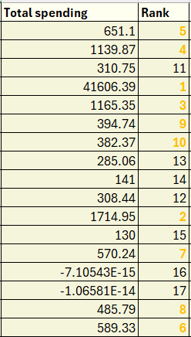
Customer Ranking Analysis
The ranking highlights one customer with exceptionally high total spending of 41,606.39, securing Rank 1, far above all others.
The second-highest spender is at 1,714.95, indicating a massive gap between the top spender and the rest of the customers.
Mid-range spenders include values like 1,165.35 (Rank 3) and 1,139.87 (Rank 4), showing moderate customer spending activity.
Lower mid-range spenders fall around 651.1 (Rank 5), 589.33 (Rank 6), and 570.24 (Rank 7).
Rankings below the top 10 show more modest spending, such as 308.44 (Rank 12) and 285.06 (Rank 13).
Very low spending values like 141 (Rank 14) and 130 (Rank 15) indicate minimal purchasing behavior.
The dataset includes extremely small or zero-equivalent totals (e.g., -7.1E-15, -1.06E-14), likely rounding artifacts representing customers with no actual spending.
This section delves into identifying top customers based on their total spending. By summing expenditures and applying ranking functions, we aim to highlight the most valuable clients for targeted marketing efforts and relationship management enhancements.

Slide 8
Temporal Sales Trends
Sales show a clear upward trend from the first year to the next, reaching their highest point in the middle period.
After peaking, sales drop noticeably in the following year, indicating a slowdown in performance.
The sharp fall to zero in the “Jan-1900” category signals an incorrect or missing date entry, not an actual sales value.
The “blank” category also reflects unassigned or invalid dates that need correction.
Overall, the valid years follow a rise-and-fall pattern, with strong growth before declining.
This section explores temporal sales fluctuations and seasonality, showcasing how sales vary across the year. By analyzing these trends, we can identify peak sales periods and make informed decisions regarding inventory management and marketing strategies for optimal performance.

Slide 9
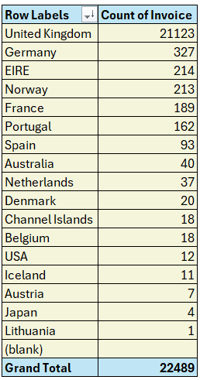
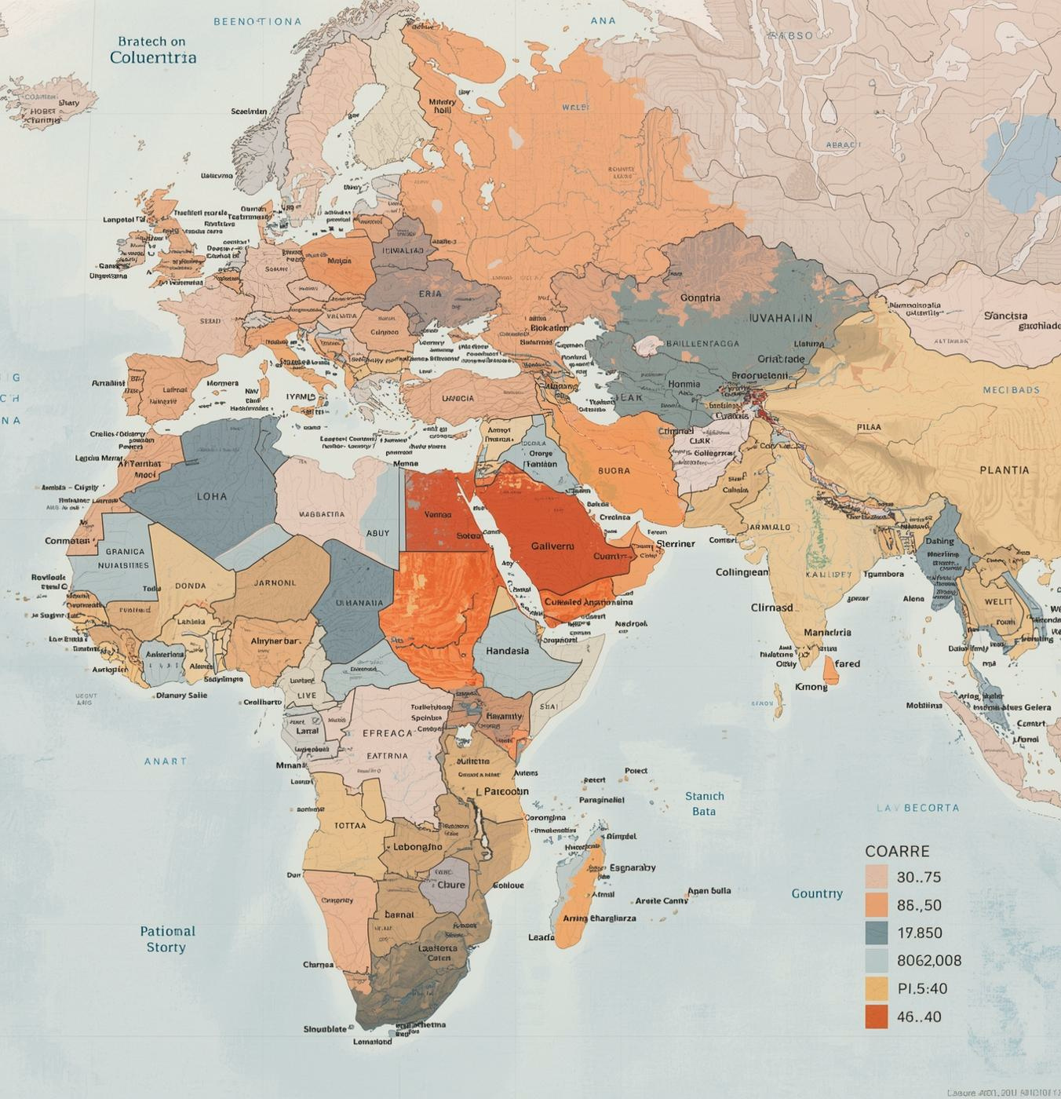
Geographical Insights
The United Kingdom clearly dominates the invoice count, far exceeding all other countries.
European countries like Germany, EIRE, Norway, and France contribute moderate volumes, forming a strong secondary cluster.
Countries such as Portugal and Spain show smaller but steady activity, indicating selective customer presence.
Non-European markets like Australia and the USA appear with very low counts, suggesting limited international reach.
Several countries including Iceland, Austria, Japan, and Lithuania show minimal participation, reflecting niche or rare transactions.
This section analyzes transaction distributions(Count of Invoice) across various countries, providing insights into market concentration and customer behavior. Understanding geographical sales patterns helps identify opportunities for expansion and informs strategic business decisions for targeted marketing efforts in different regions.

Slide 10
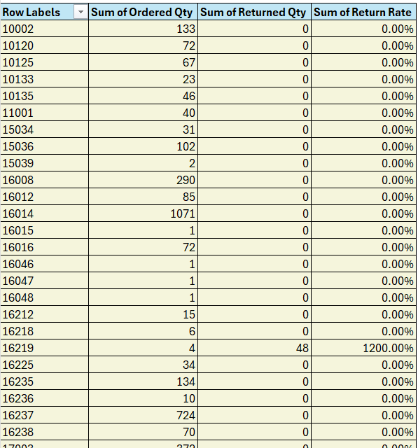
Return Rates
Product Return Rate
Analyzed returns based on negative quantities, calculating return rates to identify products needing quality review and customer satisfaction improvements.
The pivot table compares the total quantities ordered with the quantities returned for each product. Most products display a 0% return rate, indicating no recorded returns in the data. A few products show noticeably higher return percentages, which may warrant closer review. These variations highlight where product-specific .

Slide 11

Data Segmentation
Customers categorizes into High, Medium, and Low revenue tiers based on quartile thresholds.
A large portion of customers fall into the High tier, indicating strong spending concentration among many buyers.
The Medium tier includes a smaller group with moderate revenue contribution, suggesting mid-level engagement.
The Low tier consists of customers with minimal or negative revenue values, highlighting low activity or potential refunds.
The balanced distribution between tiers helps identify premium customers versus those needing engagement strategies.
The tiering system allows businesses to tailor personalized marketing, retention plans, and promotional offers.
Overall, the segmentation provides a clear structure for customer value analysis and future decision-making.

Slide 12
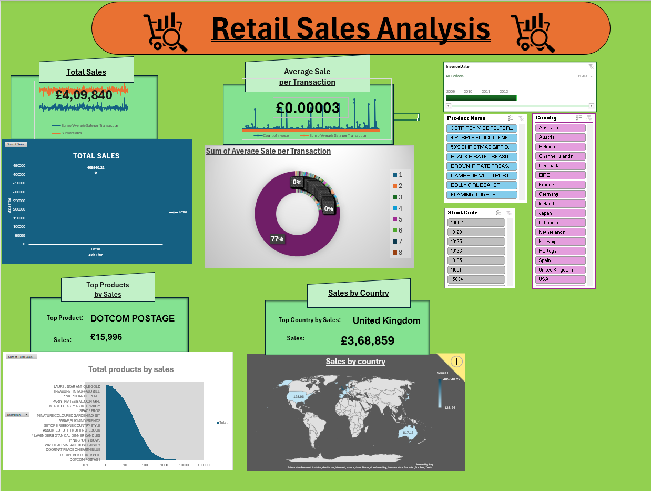
D
A
S
H
B
O
A
R
D

Slide 13
Dashboard Insights
The retail sales dashboard shows strong performance, with Total Sales surpassing £4 million. The United Kingdom emerges as the primary revenue driver, far ahead of other countries. COOKING POSTAGE stands out as the top-selling product, reflecting high customer demand. Average Sale per Transaction remains steady across regions, suggesting consistent buying patterns. Sales by Country charts highlight the clear dominance of the UK compared with markets like Portugal and Spain. Product-level analysis shows that a few key items contribute significantly to overall revenue. Overall, the dashboard provides clear segmentation insights and points toward strategic opportunities for product and market expansion.
The interactive dashboard consolidates KPIs for executive decision-making, showcasing total sales, average transaction values, and top products. Utilizing slicers enhances data filtering by time periods and categories, facilitating dynamic analysis and actionable insights for strategic planning.

Slide 14

https://youtu.be/ZvlNx16iYMM Watch the entire presentation on YouTube.

